Slide 1
OpenChain Monthly Meeting
2023-12-19

Slide 2
Anti-Trust Policy Notice
Linux Foundation meetings involve participation by industry competitors, and it is the intention of the Linux Foundation to conduct all of its activities in accordance with applicable antitrust and competition laws. It is therefore extremely important that attendees adhere to meeting agendas, and be aware of, and not participate in, any activities that are prohibited under applicable US state, federal or foreign antitrust and competition laws.
Examples of types of actions that are prohibited at Linux Foundation meetings and in connection with Linux Foundation activities are described in the Linux Foundation Antitrust Policy available at http://www.linuxfoundation.org/antitrust-policy. If you have questions about these matters, please contact your company counsel, or if you are a member of the Linux Foundation, feel free to contact Andrew Updegrove of the firm of Gesmer Updegrove LLP, which provides legal counsel to the Linux Foundation.

Slide 3
Regular Agenda
News
Work on standards and core material
Any other business
Close of meeting

Slide 4
News

Slide 5
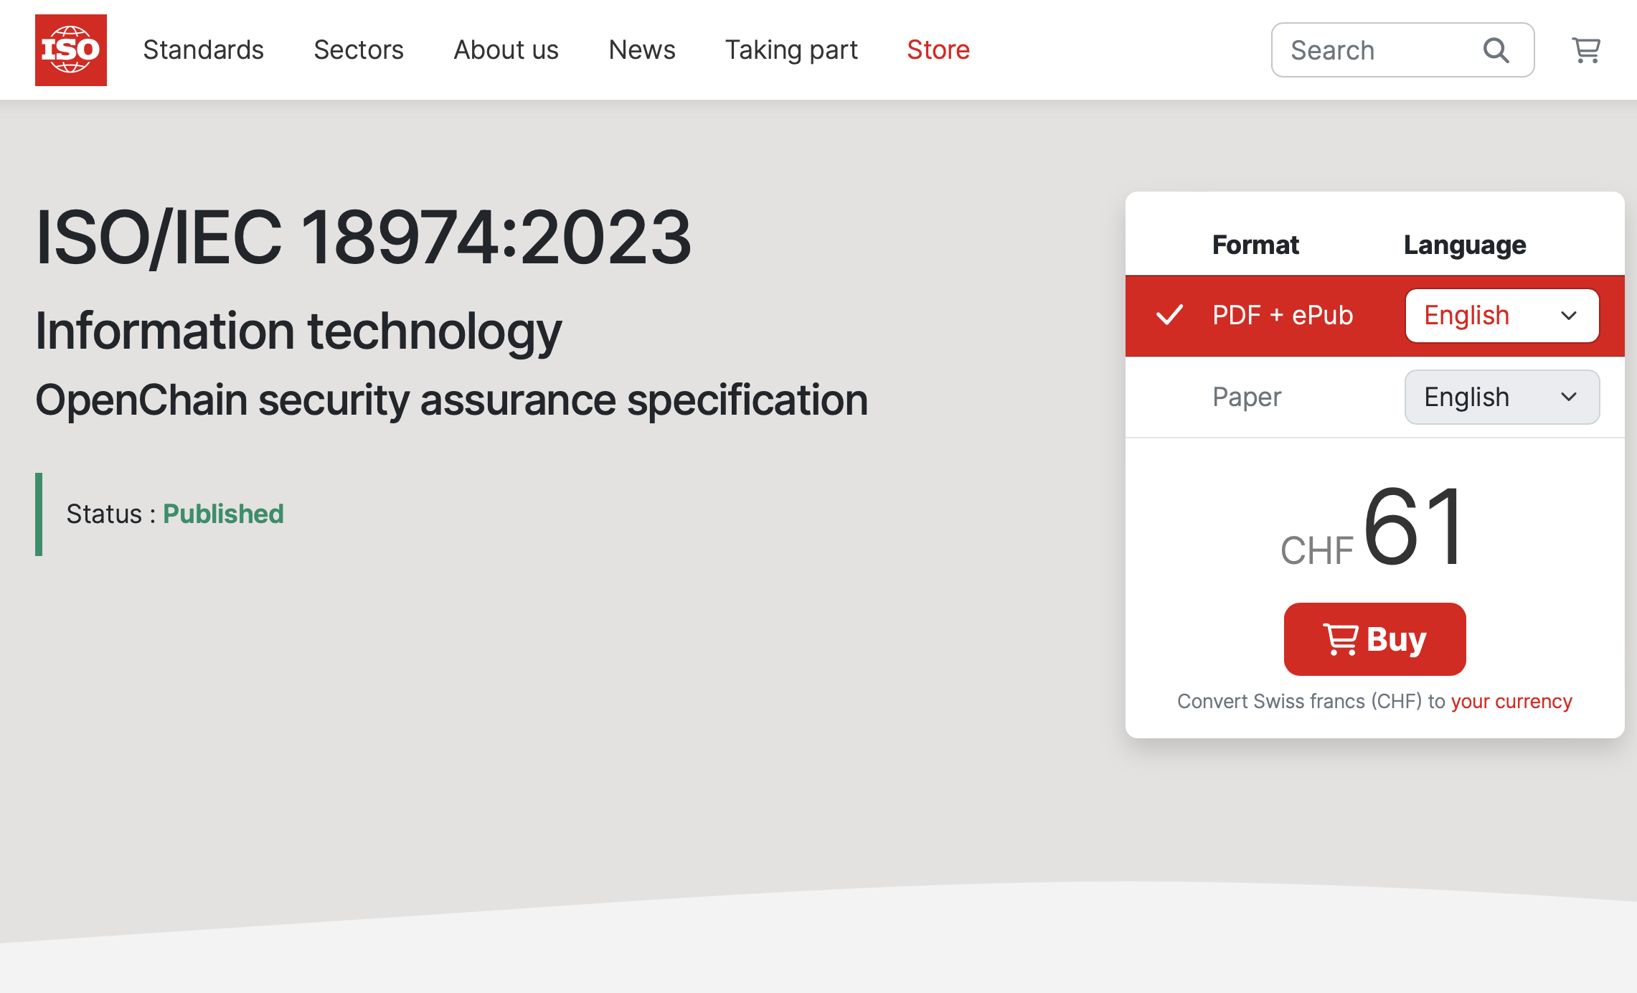
ISO/IEC 18974:2023 has been Published

Slide 6
Work on standards and core material

Slide 7
What Happens Next
We were working on the proposals for:
OpenChain License Compliance 3.0 (ISO/IEC 5230:2020 next gen)
OpenChain Security Assurance 2.0 (ISO/IEC 18974:2023 next gen)
OpenChain Contribution Process Management 1.0 (name TBD)
OpenChain SBOM Quality Specification 1.0 (discussion is still underway in Telco about next steps)
Some of these went before the OpenChain Steering Committee in early December for review.
The Steering Committee provided formal guidance on where to go next.

Slide 8
Formal Starting Point For Steering Committee
The OpenChain Specification Work Group explored updates to our existing licensing and security specifications (ISO 5230 + ISO 18974), while also providing a forum for discussion about future specification proposals. They held bi-weekly meetings on our Global Work Group calls with everyone invited.
The material ready for review related to updates to our licensing and security specifications.
There were also future specification proposals related to contribution processes (building on ISO 5230 contribution requirement) and SBOM quality (from our telco work group). Neither are ready for official Steering Committee review.

Slide 9
Proposed Licensing Specification Update
OpenChain ISO/IEC 5230 (OpenChain 2.1) has been locked as a specification since 2019 and released as an ISO standard since 2020.
In that time period various comments have come in regarding improvements or adjustments to assist with market requirements.
The OpenChain Specification Work Group has been formally reviewing this suggestions and comments since November 2022.
They were ready to present the current draft update to the Steering Committee for review.

Slide 10
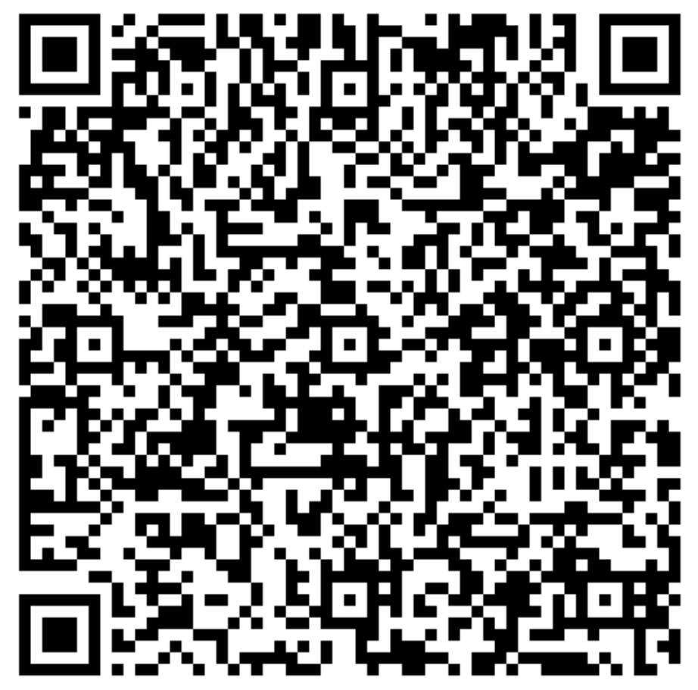
The Current and Draft Versions
Licensing Specification (CURRENT VERSION, 2nd Generation):
https://github.com/OpenChain-Project/License-Compliance-Specification/blob/master/2.1/en/openchainspec-2.1.md
Licensing Specification (3rd Generation Draft):
https://github.com/OpenChain-Project/License-Compliance-Specification/blob/master/Official/en/3.0/openchain-license-compliance-3.0.md
QR code is for the 3rd Generation Draft:

Slide 11
Proposed Security Specification Update
OpenChain ISO/IEC 18974 (OpenChain Security Assurance 1.1) has been locked as a specification since 2022 and released as an ISO standard since November 2023.
Prior to release as an ISO standard it was socialized with JTC-1 WG/SC 27, ICT Security, as a courtesy to ensure alignment with their work.
They provided editorial notes that were largely include in the existing specification and they provided scope expansion suggestions that were deferred to the next iteration.
The OpenChain Specification Work Group has been reviewing these update suggestions and soliciting more since June, and was ready to present the current draft update to the Steering Committee for review.

Slide 12
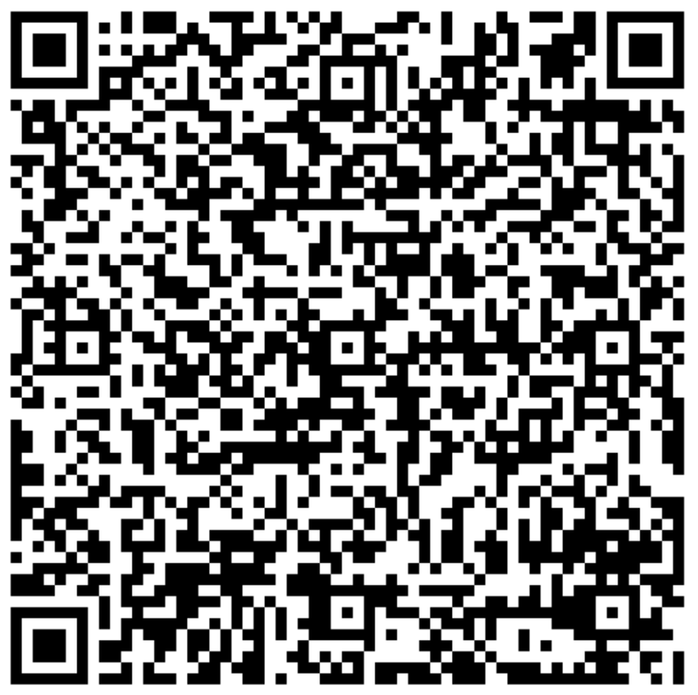
The Current and Draft Versions
Security Specification (CURRENT VERSION, 1st Generation):
https://github.com/OpenChain-Project/Security-Assurance-Specification/blob/main/Security-Assurance-Specification/1.1/en/openchain-security-specification-1.1.md
Security Specification (2nd Generation Draft):
https://github.com/OpenChain-Project/Security-Assurance-Specification/blob/main/Security-Assurance-Specification/2.0/en/openchain-security-specification-2.0.md
QR code is for the 2nd Generation Draft:

Slide 13
Steering Committee Conclusions
The proposed updates seem reasonable.
We will create a longer period for public comments and freeze to ensure more people can share their thoughts.
We do not want to update our standards too often.
It is not decided yet, but our provisional five year update cycle seems suitable for the license compliance standard (ISO 5230). This suggests an update in 2025.
It is not decided yet, but the security assurance standard (ISO 18974) may get an update sooner than the five year cycle due to market changes.

Slide 14
Any other business

Slide 15
Outcomes of Open Compliance Summit 7-8 December in Japan

Slide 16


Slide 17


Slide 18
Open Compliance Summit 2023
Our Goals and Reasons
In 2022 the Open Compliance Summit rebooted after COVID
We had a one day event with mostly Japanese attendees in 2022
For 2023 we wanted to have a two day event with a truly international audience
Our goal was to retake global leadership in open source legal events

Slide 19
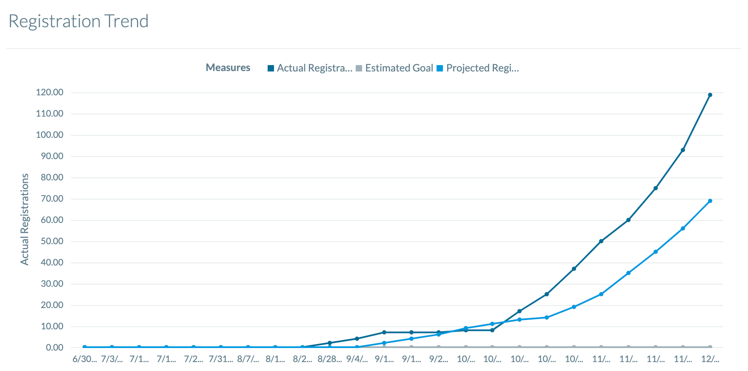
Open Compliance Summit 2023
Registered: 119
Cancelled: 4
Registrations were ahead of projections
22.7% of the audience were speakers or panelists by design
We are still awaiting the formal LF Event survey, but attendee response was positive, and we had excellent representation from China, Korea, North America, Europe and Taiwan. This seems to have been our most international event with the strongest program yet.

Slide 20
Event Opening: Welcome International Attendees!
This year we have people from so many places coming to share knowledge!
A special welcome to old and new friends from China and Korea.
Great thanks to those who crossed the world to get here.
Please accept our appreciation for taking time to improve the supply chain by sharing experiences.

Slide 21
Key Opening Point: We Changed The Market
OpenChain ISO/IEC 5230 for open source license compliance
OpenChain ISO/IEC 18974 for open source security assurance
SPDX ISO/IEC 5962 for open source software bill of materials

Slide 22
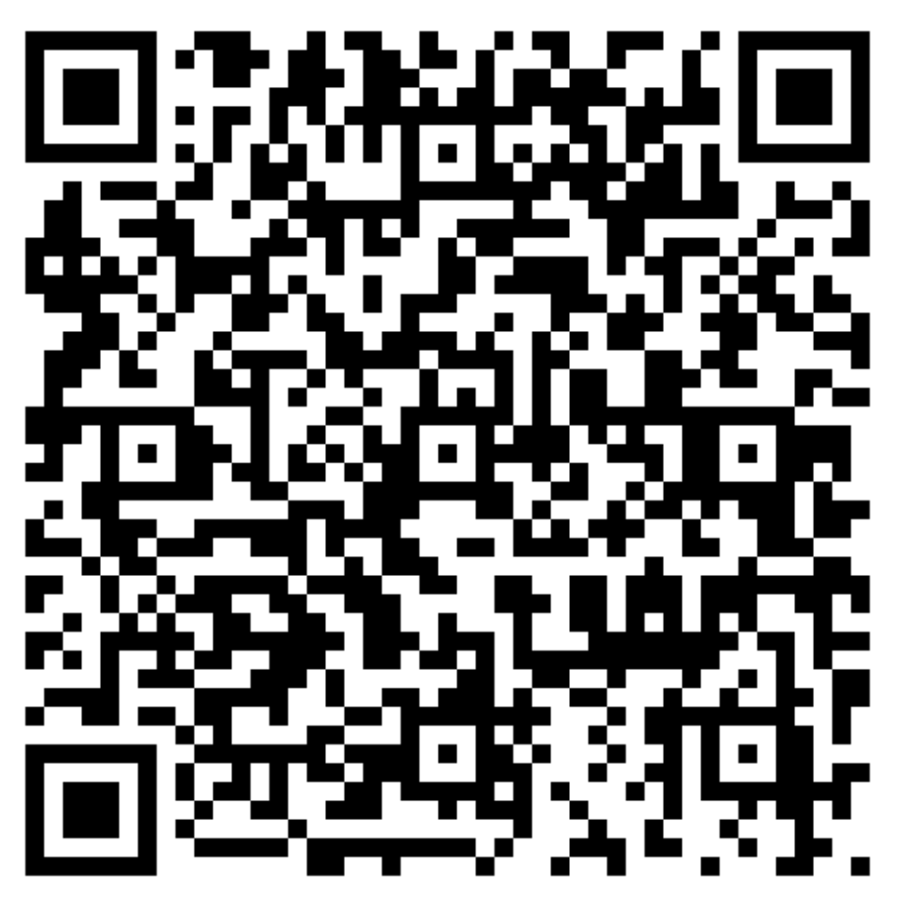
Full Schedule

Slide 23
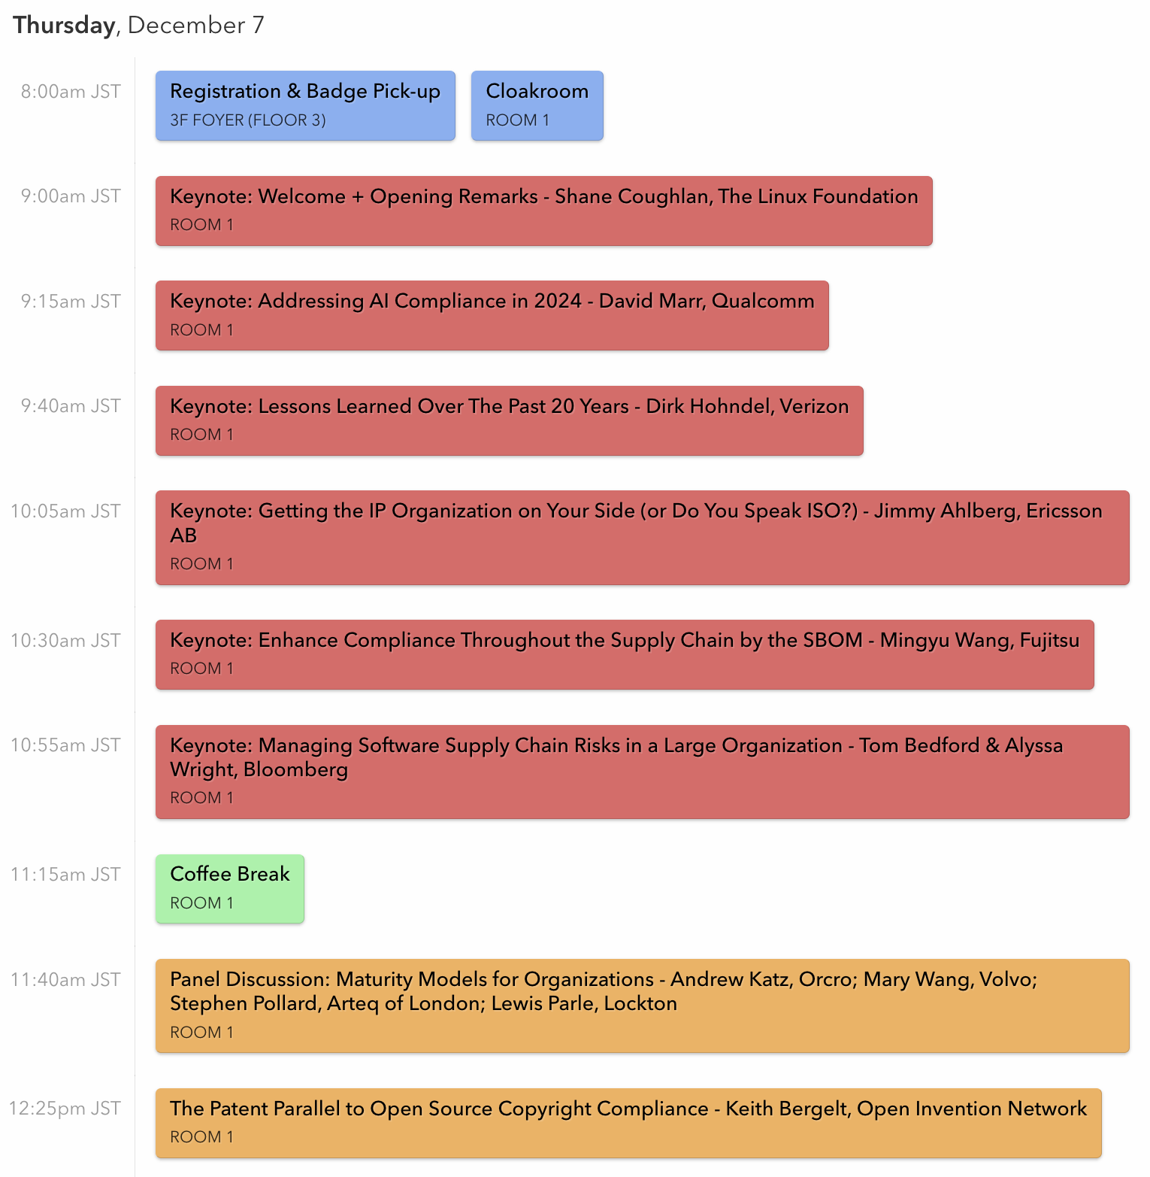
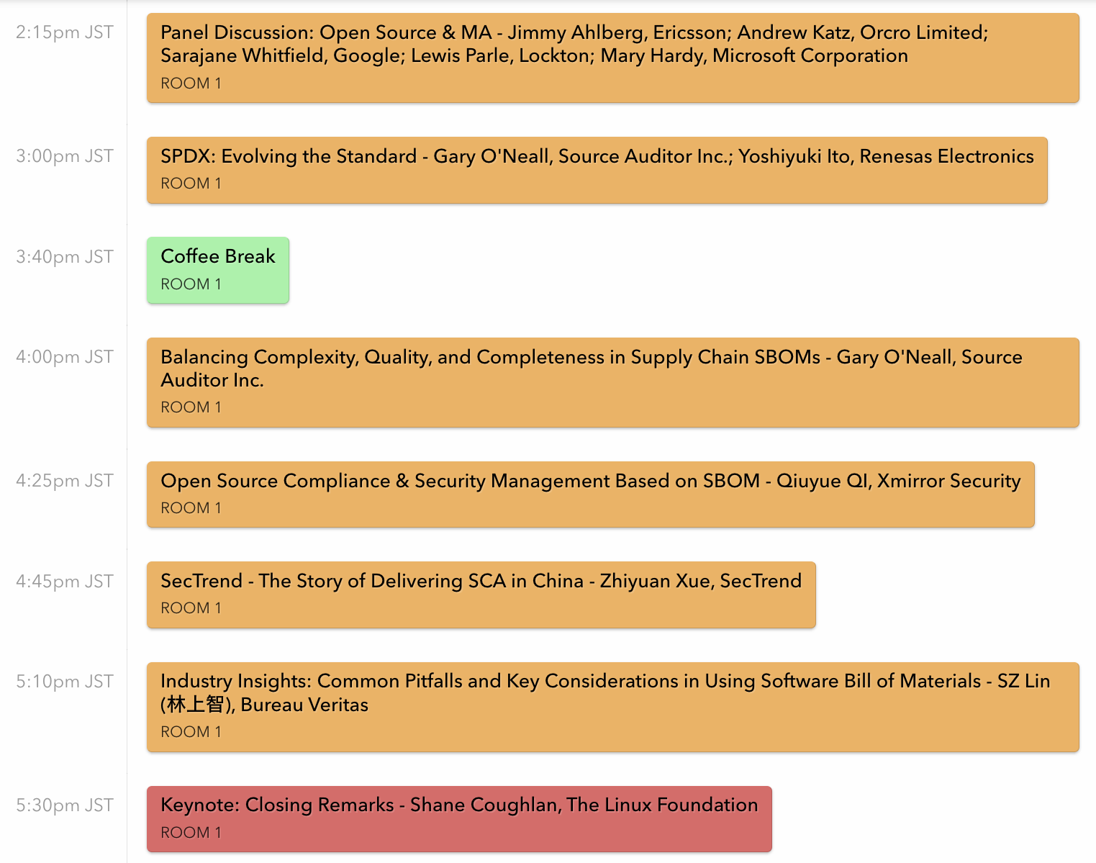
Day 1

Slide 24
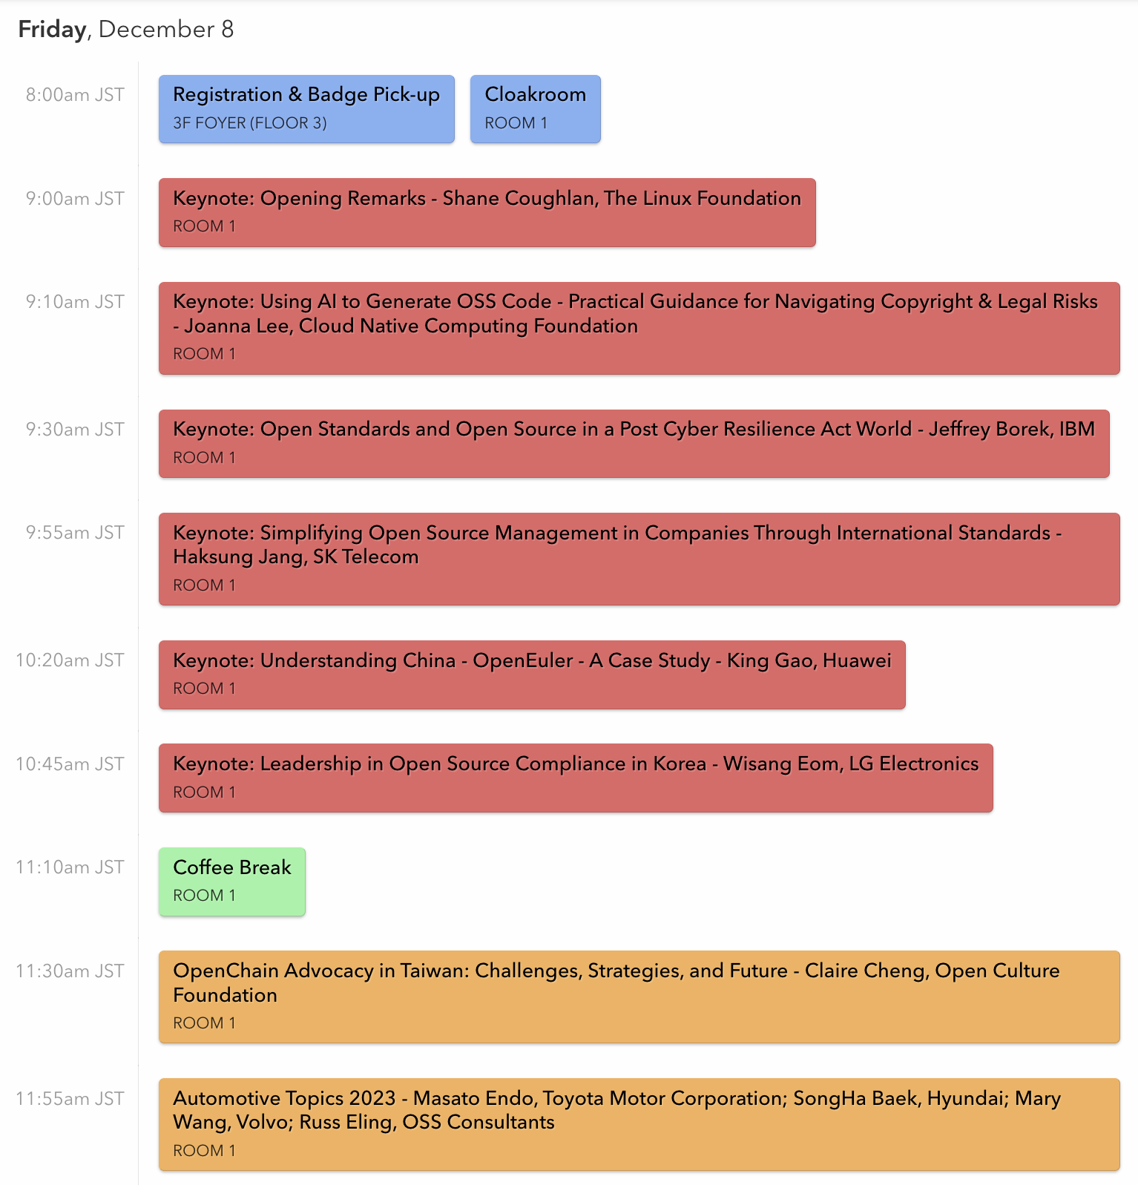
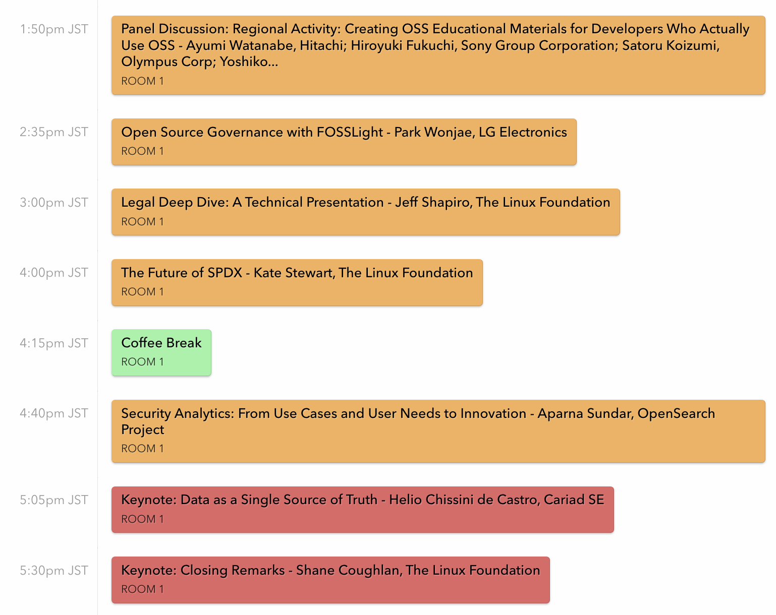
Day 2

Slide 25
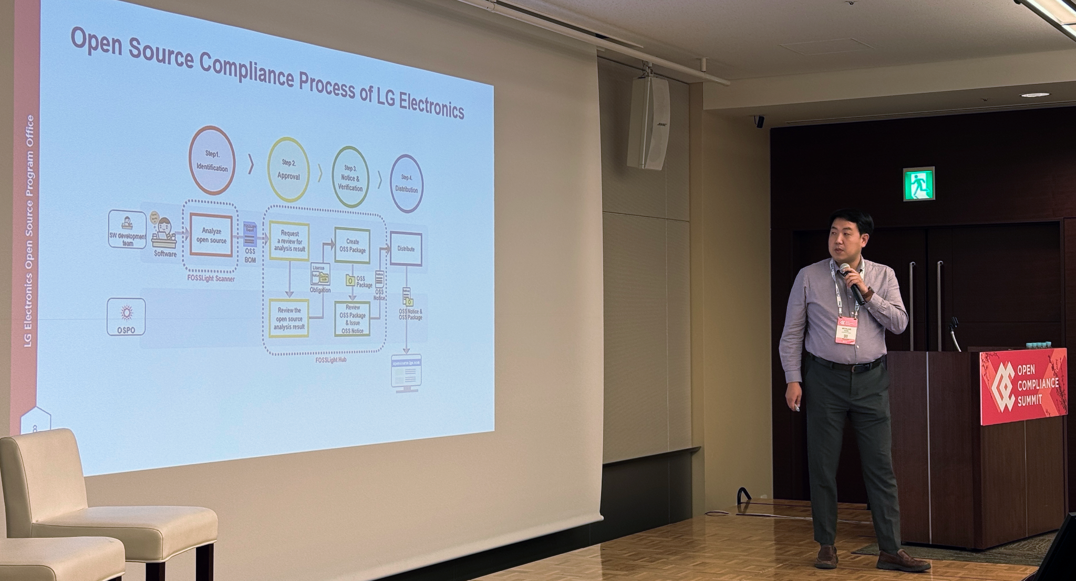
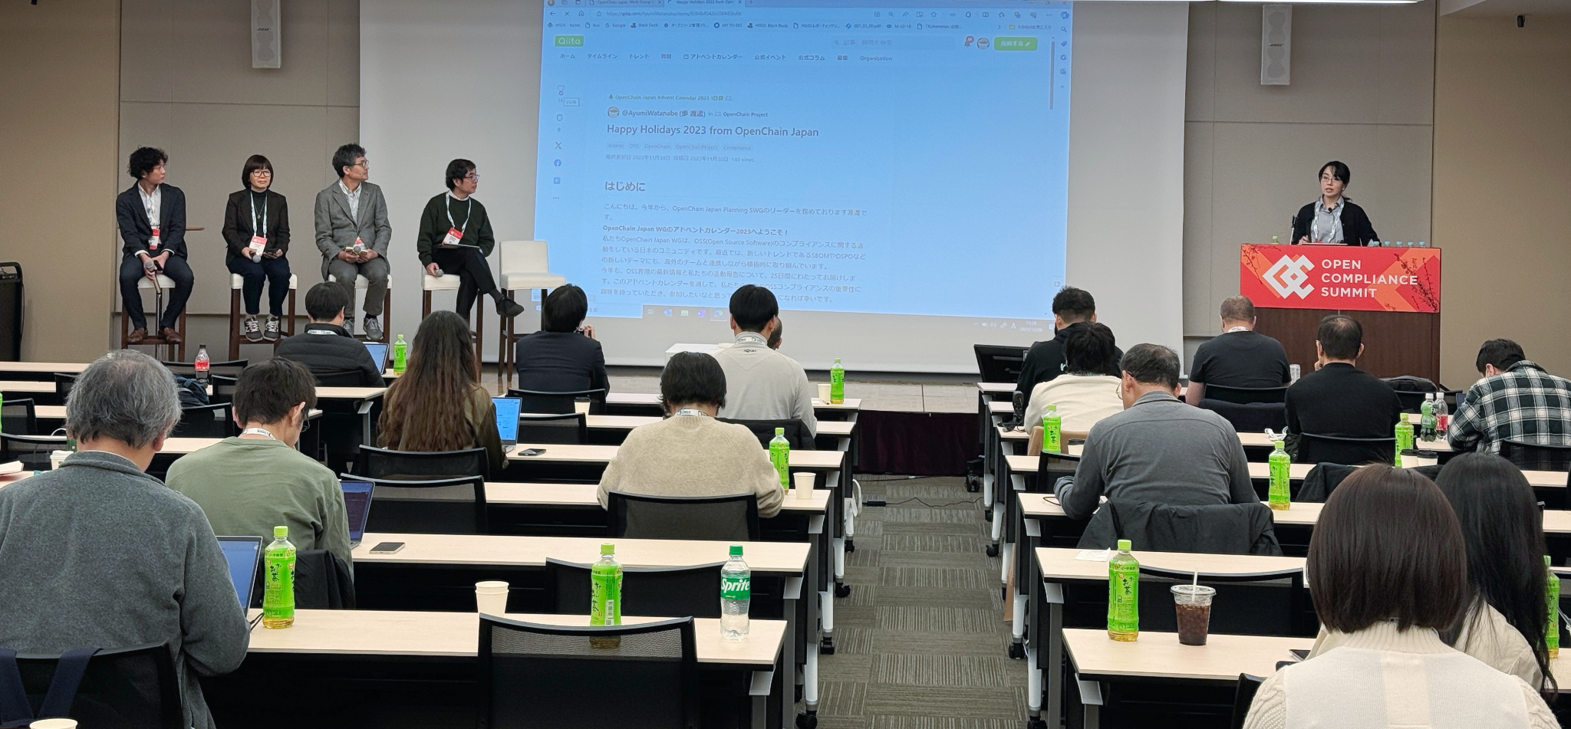
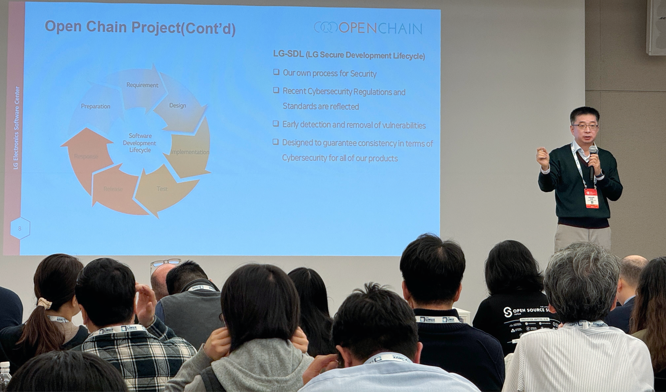
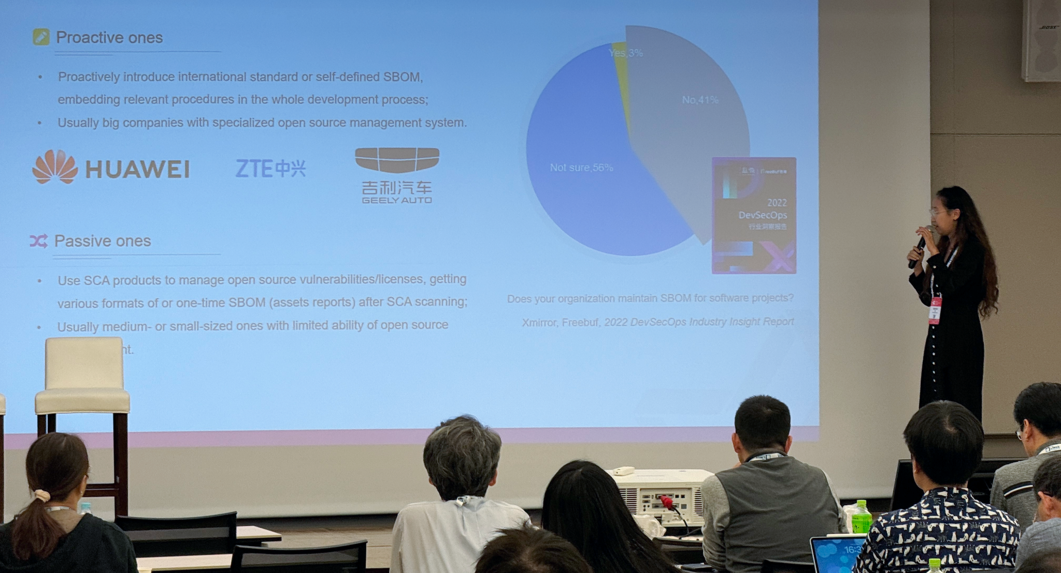
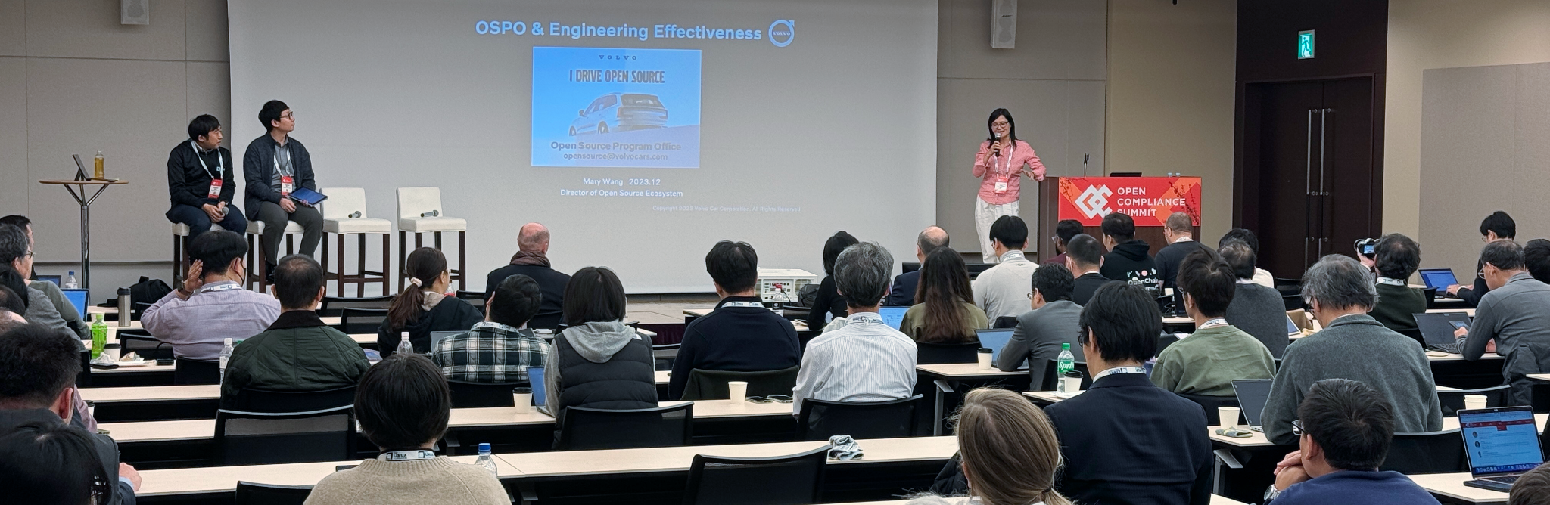
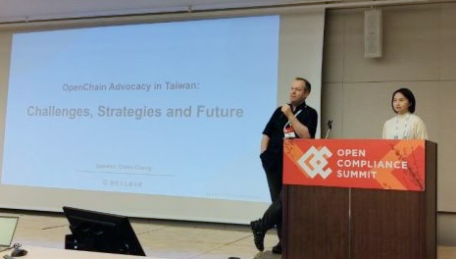
Open Compliance Summit 2023

Slide 26
Close of meeting

Slide 27
See you next time!

